Slide 1

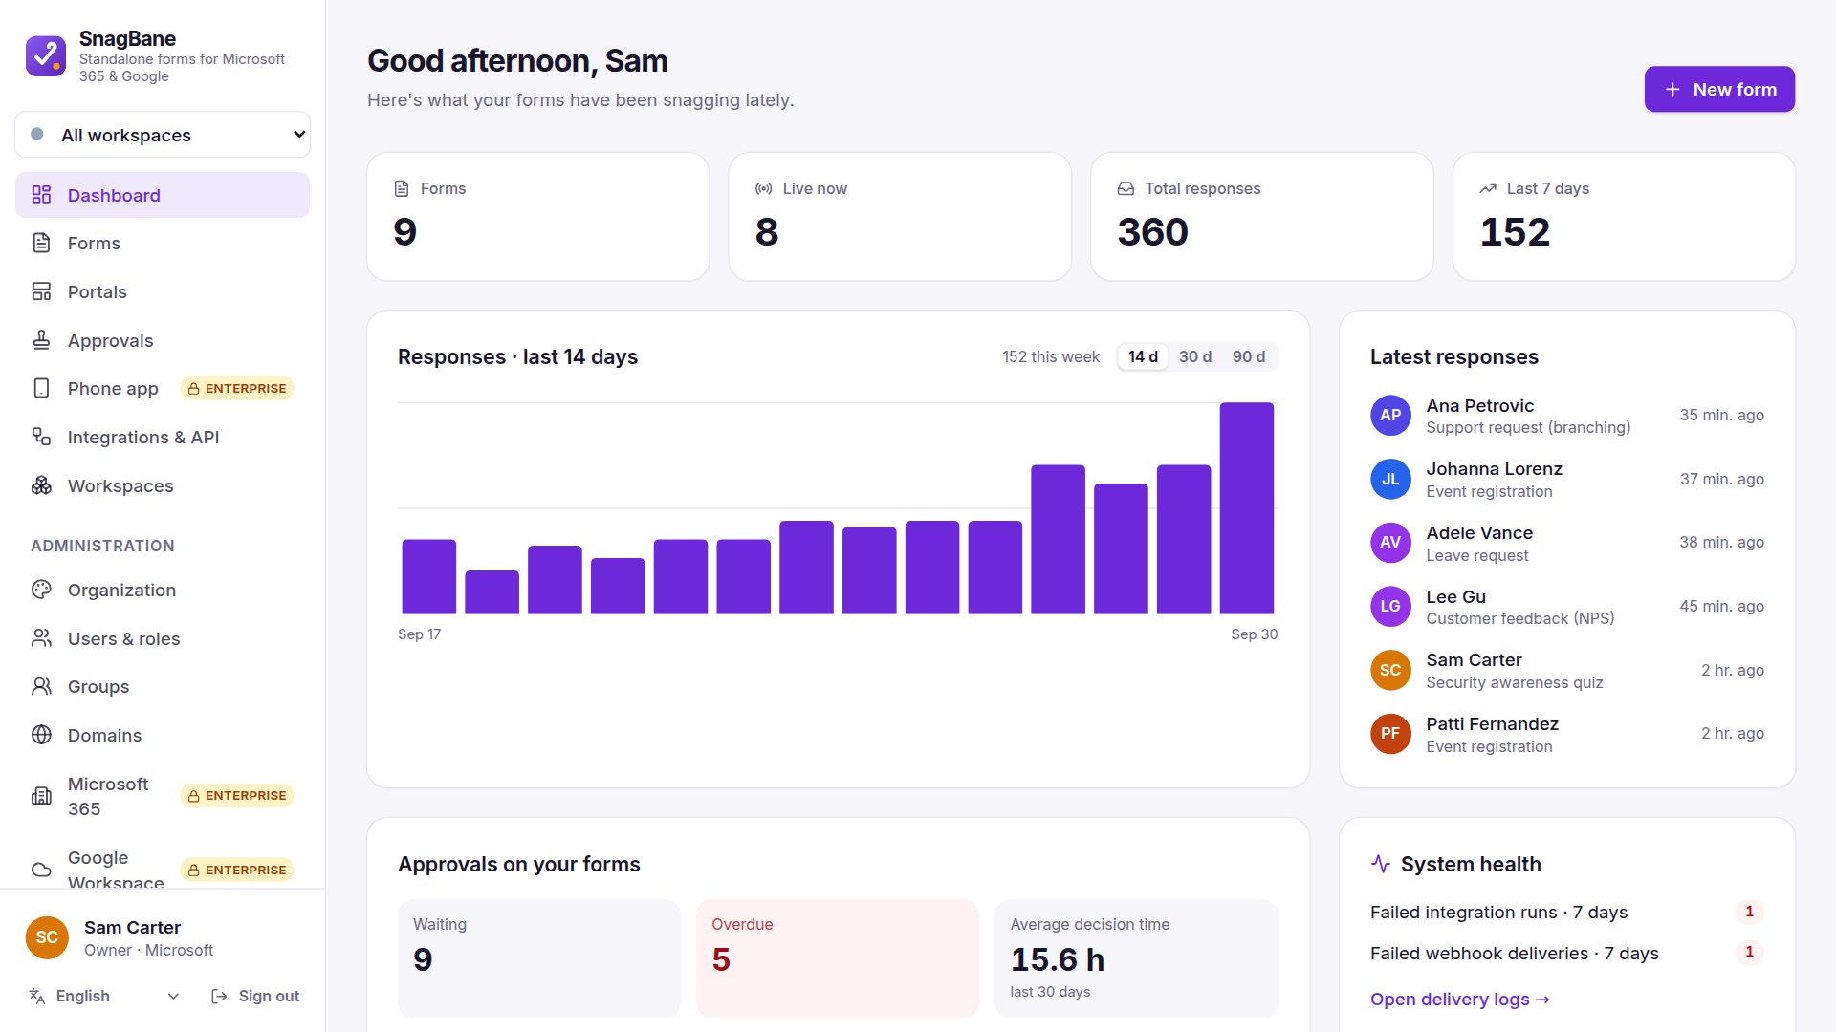
Every request and approval in one place
Self-hosted forms and approvals that work with Microsoft 365, Google Workspace and Okta.
snagbane.com
Notes:
Open with the outcome: one place for every request, less chasing. SnagBane runs on the company's own server.

Slide 2
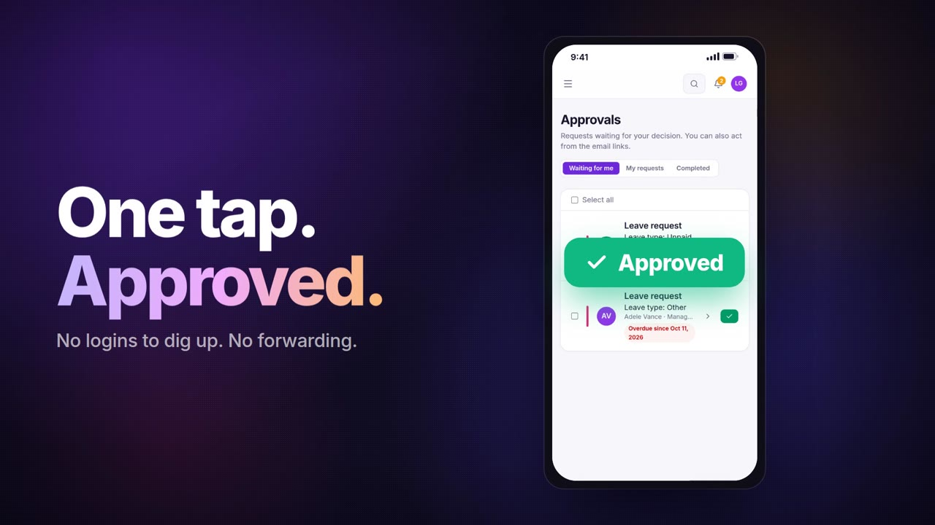
SnagBane in one minute
Notes:
Play the 57-second film: from the inbox chase to a request approved in one tap, the portal, the phone and the integrations.

Slide 3



Requests still live in inboxes and spreadsheets
Lost in email
Nothing moves
Old tools, one-off fixes
Leave, purchases and IT access go back and forth by email. Nobody knows who has to decide next.
Requests wait for days because an approver missed the message, and someone has to chase them.
InfoPath is retired, and building a Power Automate flow for every process doesn’t scale.
Notes:
Ask the client which of these they recognise. Most companies have all three.

Slide 4
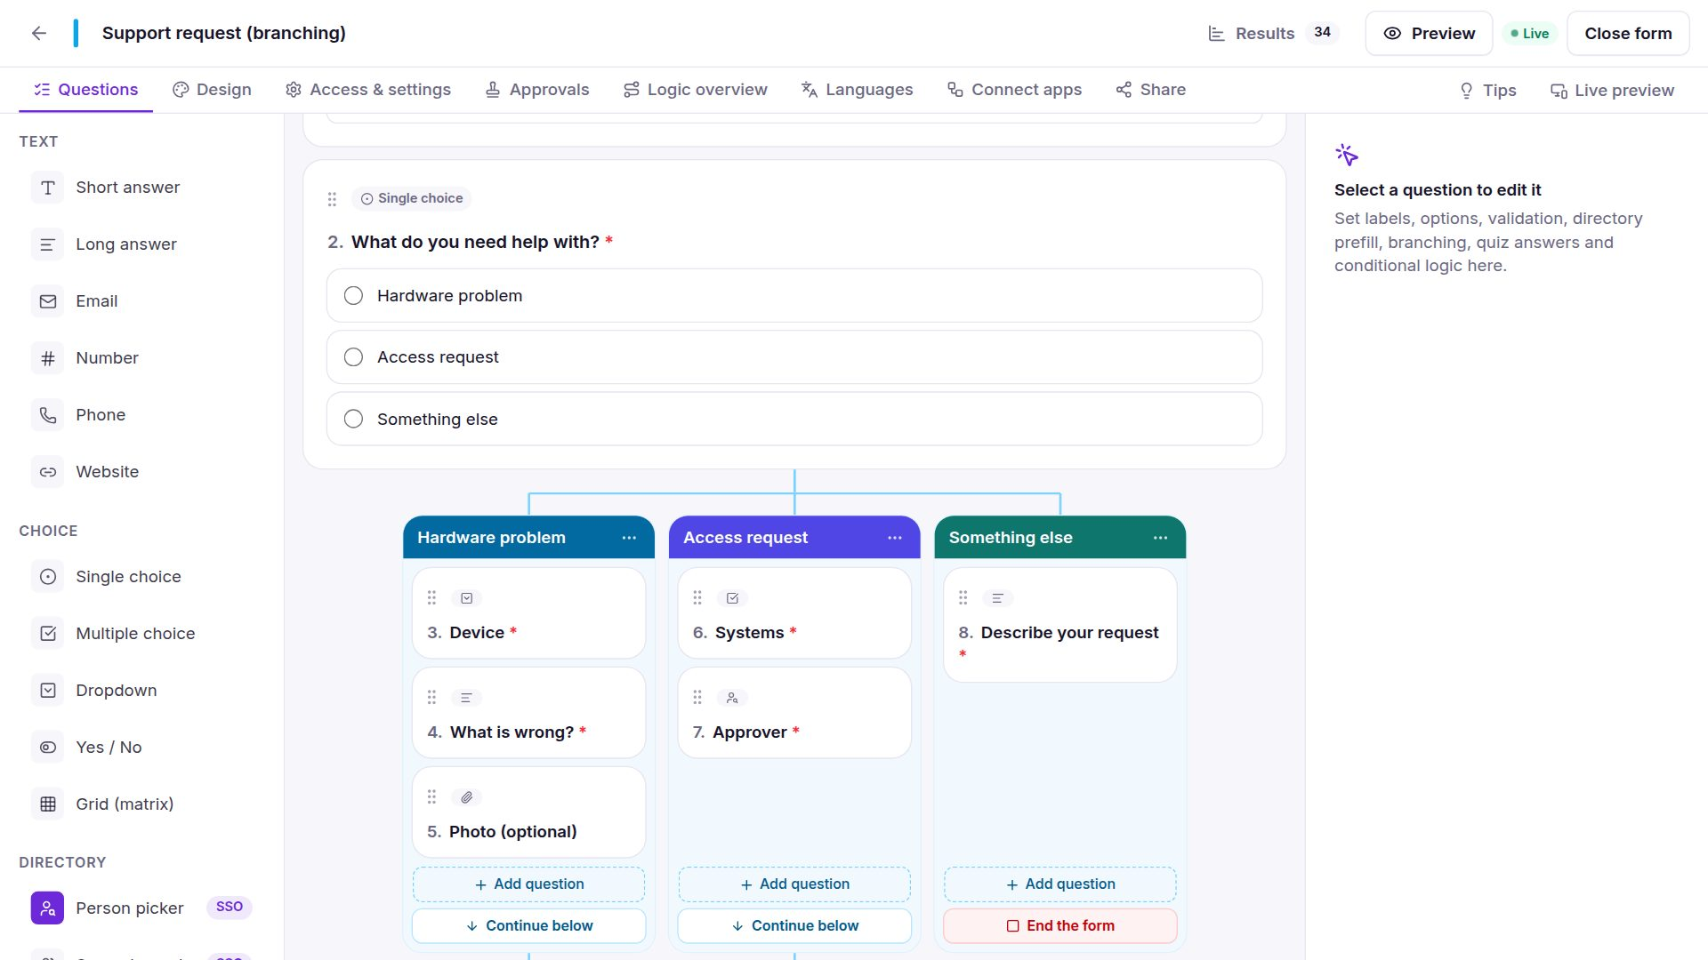
One system for every process
1
Forms in minutes
Start from 100+ templates or import Microsoft Forms, Google Forms and InfoPath.
2
Approvals that move
Managers, groups and several stages, with reminders and deadlines.
3
Automatic follow-up
Results go to SharePoint, Excel, Jira, Teams and more after the decision.

Slide 5
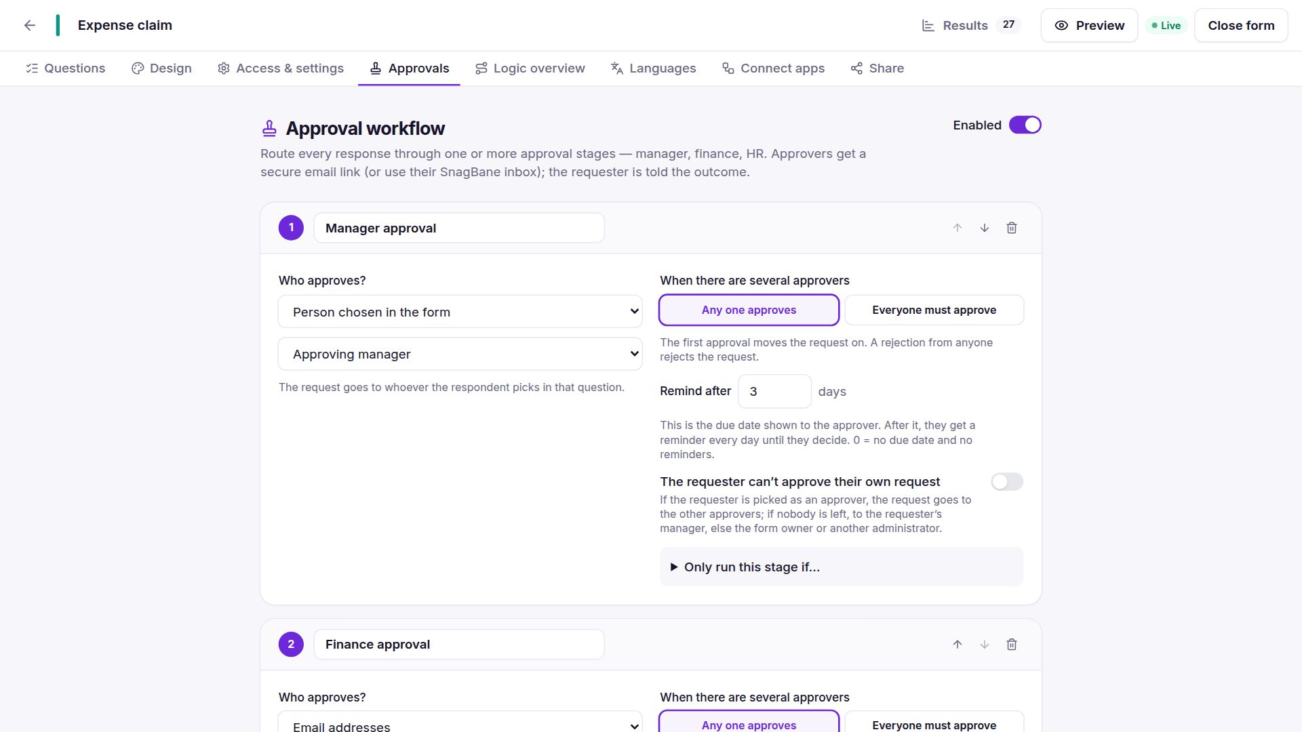
Approvals with clear rules
Manager, person chosen in the form, group or email
Any one or everyone must approve
Reminders and due dates per stage
The requester can’t approve their own request
Change the approver when someone is away

Slide 6
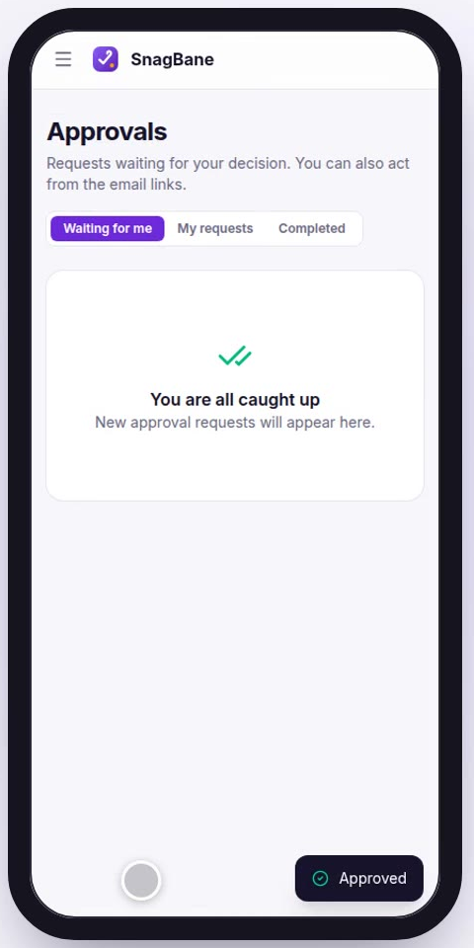



Decide in one tap, anywhere
Email
A secure link in every approval email
Microsoft Teams
Approvals as a Teams app with notifications
Phone
An app on the home screen with push notifications
Notes:
Teams approvals and the phone app are part of the Business and Enterprise plans.

Slide 7
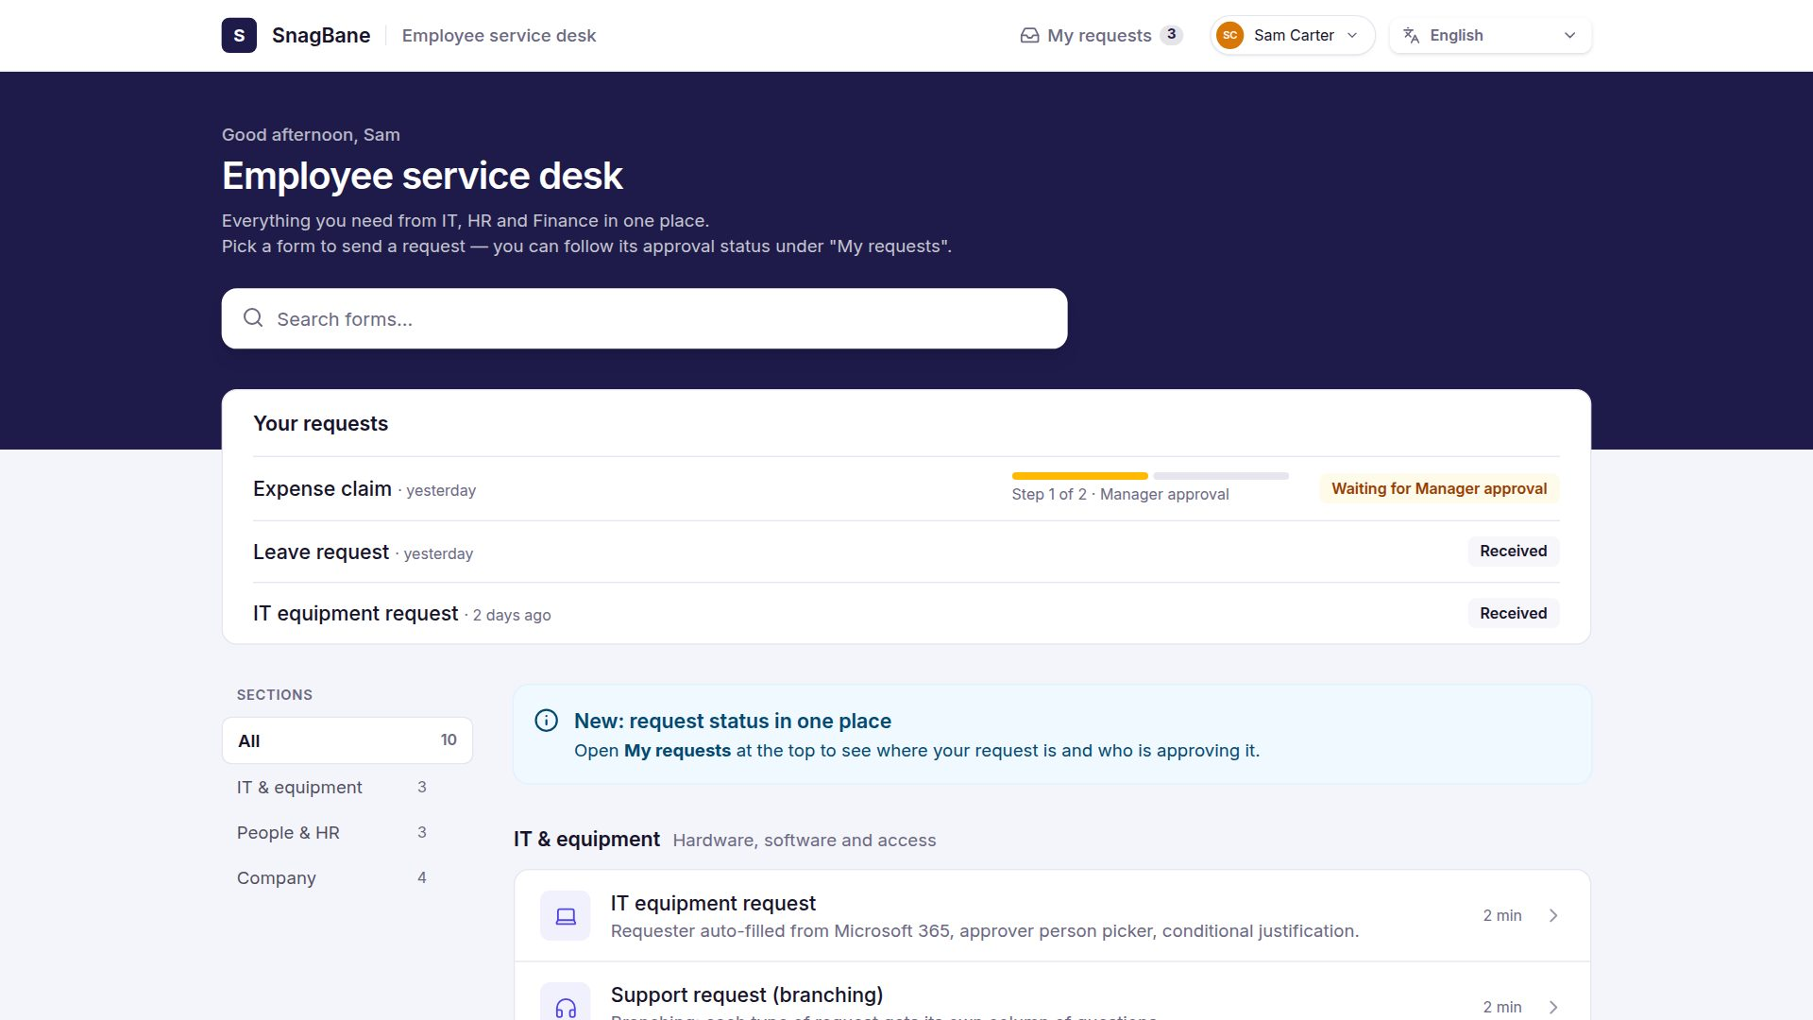
One portal for every request
Employees find every form in one place and follow their own requests step by step.
Works as a web page or as a tab in Microsoft Teams, in the company’s colours, with 20 looks to choose from.

Slide 8
Works with the tools you already use
Microsoft 365
Teams
SharePoint
Excel
Outlook
Power Automate
Google Workspace
Gmail
Google Sheets
Okta
Slack
Jira
Trello
Asana
monday.com
ClickUp
Salesforce
Dynamics 365
DocuSign
Stripe
Zapier
Make
n8n
REST API
Plus webhooks for anything else. Integrations depend on the plan — see snagbane.com/integrations.

Slide 9






Your server. Your data.
Self-hosted
Single sign-on
Two-step sign-in
Runs on your own server: Docker, Linux or PHP hosting
Microsoft Entra ID, Google, Okta and SAML
Authenticator app, security keys and passkeys
Audit logs
SCIM provisioning
Access control
Every change logged, forwarded to your SIEM
People and groups kept in sync automatically
IP allowlist, data retention, roles and groups
Notes:
SIEM forwarding, SCIM, IP allowlist and data retention are in the Enterprise plan. Data never leaves the client’s server.

Slide 10
Plans for every size
Free
Business
Enterprise
Up to 25 people
From €149 / month
From €460 / month
Forms, approvals and portals
Everything except the security package
Business + the security package
Approval stages and reminders
Templates and import
Email approvals
Microsoft 365, Google, Okta
Teams approvals and phone app
All integrations and REST API
SIEM, SCIM, IP allowlist
Data retention and offboarding
Production + staging licence
Prices per installation, by number of people. Full price list: snagbane.com/pricing

Slide 11
Try it with your own process
1
2
3
30-day trial
Your first process
Go live
The full product on your own server, set up in under an hour.
Import an existing form or start from a template.
Keep the same installation — just activate the licence.
Your contact
Your name · Your company · you@yourcompany.com · +00 000 000 000

